Slide 1



Interaction Design
and
User Research

Slide 2
Roadmap
Introduction
Dimensions
Design
The Design Process
Users

Slide 3
INTRODUCTION
Interaction design (IxD) is not just about the design of interactive systems
Interaction design also includes the design of artifacts (e.g. tools/resources such as office equipment).
Interaction design is about the design of interaction itself.
[however]
Interaction design is not just about the artifact that is produced (physical device, computer program, etc)
Interaction design is about understanding and choosing how the artifact is going to affect the way people work or live.
Interaction design is the practice of designing interactive products, environments, systems, and services in which a designer's focus goes beyond the item in development to explore and include the way users will interact with and be affected by it.
According to Bill Verplank: interaction design is design for human use.

Slide 4
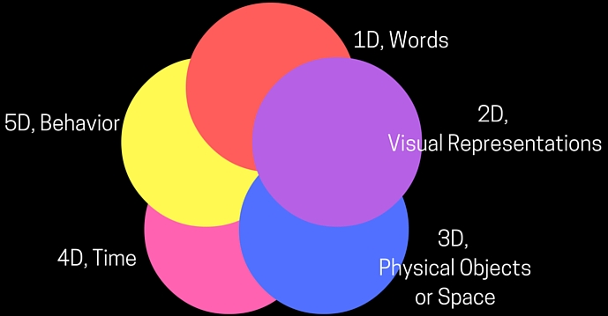
DIMENSIONS
Dimensions (or languages) of interaction design include:
1D, 2D, 3D, 4D, 5D
1D. Words: the element that users interact with (e.g. text/words).
2D. Visual representations: define elements of a user interface that the user visually perceives (e.g. typography, diagrams, icons, and other graphics).
3D. Physical objects or space: defines the objects or space with which or within which users interact.
4D. Time: refers to the time during which the user interacts with the user interface (e.g. content that changes over time such as sound, video or animation).
5D. Behavior: defines user actions and how users respond to the user interface.

Slide 5
DESIGN
Design is achieving goals within constraints.
  Goals: what is the purpose of the design that we are intending to produce, who is it for, why do they want it?
  Constraints: what materials must we use, standards, platforms, cost, time?
  Trade-offs: understand that a trade-off will be required, choose which goals or constraints to relax so that others can be met (choose the most appropriate trade-off).
The golden rule of design is: understand your materials
In the context of Human-Computer Interaction, understand your materials means:
  Understand computers: capacities, limitations, platforms, tools.
  Understand humans/people: psychological and social aspects, human error.
  Their interaction.

Slide 6
THE DESIGN PROCESS
The central message or the core of interaction design is:
the user
  Yes, the user
    at the beginning
    in the process
    at the end
  of the design process
  (recall user-centered design)

Slide 7
USERS
Know your users!
Who are they? [e.g., age, background, computer experience, etc]; probably they are not like you! (watch out the temptation to design as if you were the main user)
Some methods for knowing your users (and also for collecting user requirements):
  Personas
  Scenarios
  Cultural probes
  Questionnaires
  Interviews
  Direct observation
  etc

Slide 8
USERS
Persona
  A rich picture of an imaginary/fictional/virtual person who represents the core user group.
  A description of a user archetype that will be kept in mind when making design decisions.

Slide 9
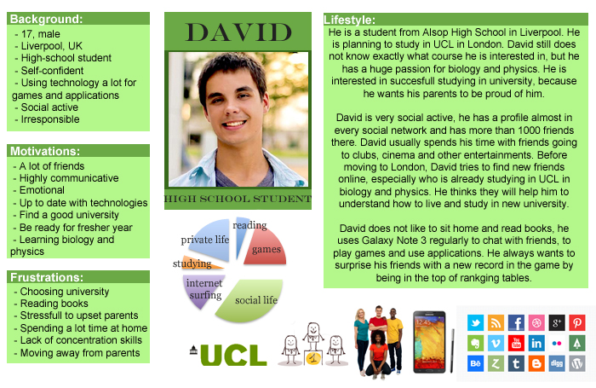
USERS
Persona
  Develop a set of personas covering different types of intended users and different roles.
  Define the personas, with details such as:
    name
    age
    job title
    picture/photo
    physical characteristics
    background
    goals
    etc
  Can be Narrative or
  Otherwise [example>]

Slide 10
USERS
Scenario
    A story for design.
    A description that envisions a person's interaction with a system.
    Example:
    It is Friday afternoon and Peter is flying out of Rome to Milan. He does not have enough money for a taxi to the airport, and he is running late. He goes to the local ATM and identifies himself. He specifies that he wants 150 Euro from his savings account. He would prefer to have the money in 20 Euro notes so that he can give the taxi driver the correct change. He does not want a printed receipt because he does not bother keeping track of transactions in his savings account.

Slide 11
USERS
Role and use of scenarios
    Help us to identify:
      characteristics of the user that may impact the design and tasks and context that the system needs to support.
      Scenarios force us to think about the design in detail and notice potential problems before they happen; we can therefore verify whether the design would make sense to the user and whether the proposed implementation architectures would work.
    Be used to communicate with others (e.g. designers, clients, users)
      it is easy to misunderstand one another whilst discussing abstract and technical ideas; scenarios being concrete/practical are thus easier to share.
    Be used to validate other models
      a detailed scenario can be 'played' against other models e.g. task and dialog models.
    Be used to express dynamics
      mere screenshots and pictures primarily give a sense of the appearance of the system; a scenario can give a sense of the behavior of the system.
  Question: What are storyboards and how are they used in the context of scenarios?

Slide 12
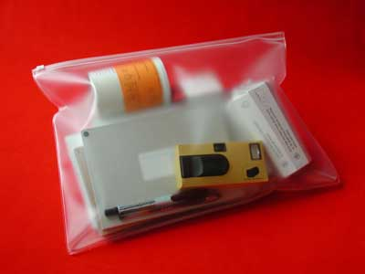
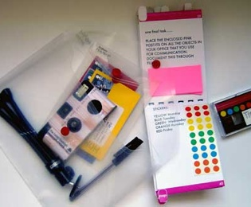
USERS
Cultural probes
  Cultural probes are (typically small) information gathering packages of items designed to provoke or prompt the user/target group to record what is meaningful to them [user/target group].
  Cultural probes are handed out to the user/target group to take away and to open and to use in their [user’s/target group’s] own environment.
  Some of the items that a cultural probe may contain include: postcards, maps, camera, photo album, media diary,...

Slide 13
USERS
Role and use of cultural probes
  Can be appropriate where direct observation is sometimes hard (e.g. in homes) or for studies that take place over a long period of time (e.g. with patients).
  Cultural probes can be used to: inform other methods (e.g. interviews), prompt ideas, enculture designers.

